Slide 1
IMAGE CLASSIFICATION
Submitted by: Anita Thapa

Slide 2
PROBLEM STATEMENT
The proliferation of social media enables people to express Images are one of the major sources of data in the field of data science and AI. This field is making appropriate use of information that can be gathered through images by examining its features and details.
The idea behind this project is to build a deep learning-based Image Classification model on images that will be scraped from e-commerce portal. This is done to make the model more and more robust

Slide 3
DATA COLLECTION PHASE
Data is scrapped from Amazon.in using selenium library.
Data scrapped from Amazon for 3 categories which are:
a) Trousers
b) Jeans
c) Saree
310 images scrapped for each category.

Slide 4
MODEL BUILDING
Data is loaded into the drive and then using google colab modelling of data is done.
Directories are made for train and test data under the folder ‘dataset_amazon’.
After that scrapped images are filled into the created directories. 20% of scrapped data is added in test dataset and the rest in train dataset randomly.
Model’s accuracy is 97% for classifying the three categories.

Slide 5
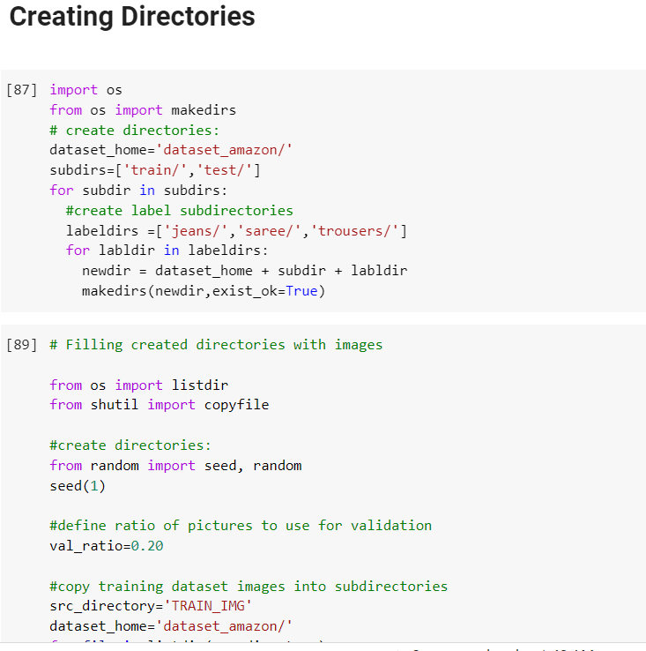
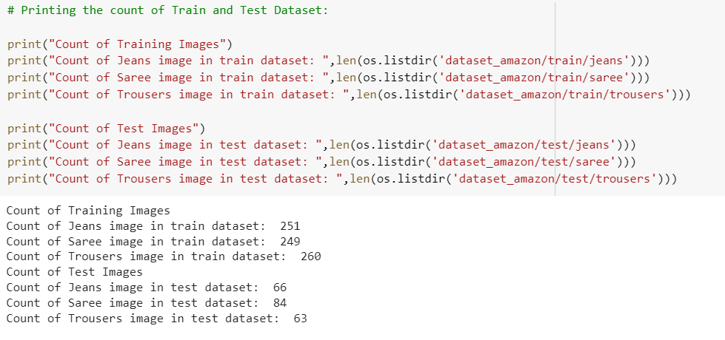
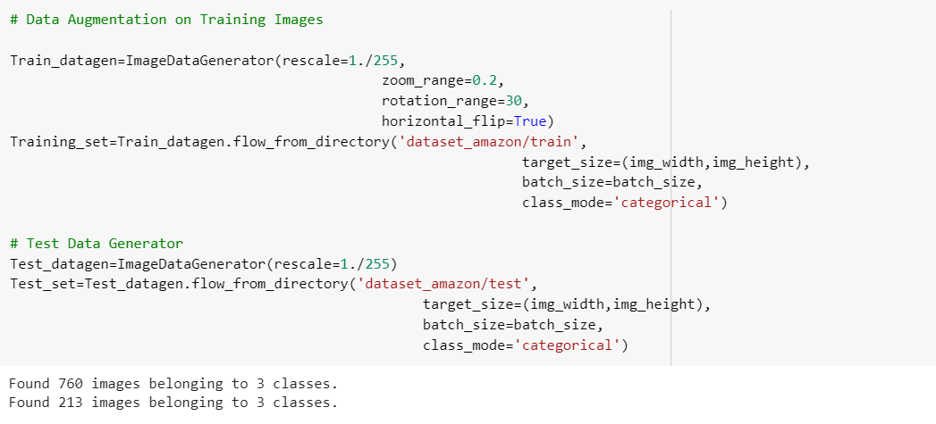

Slide 6
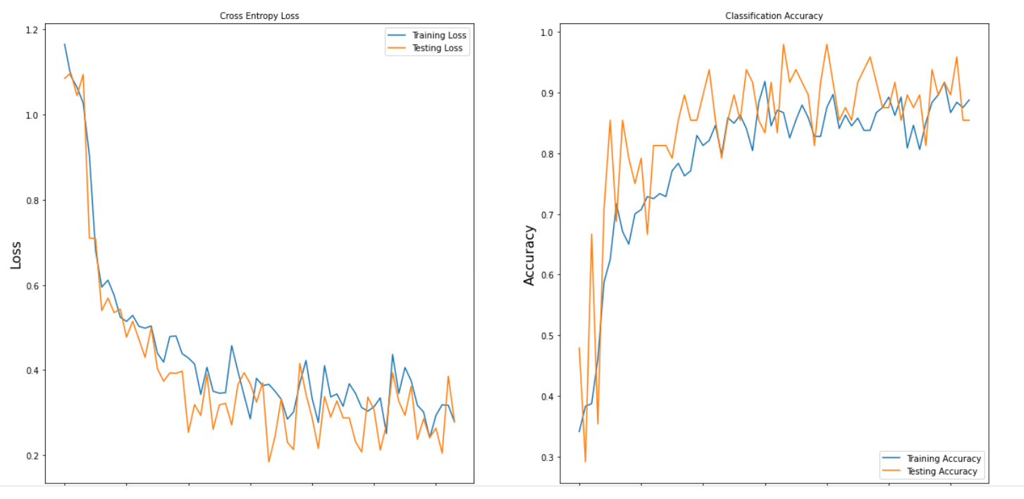
Plotting of Loss and Accuracy

Slide 7
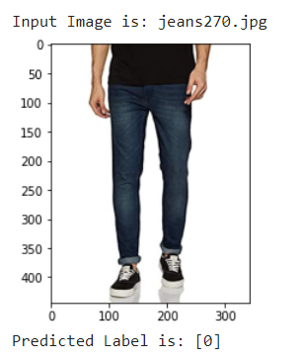
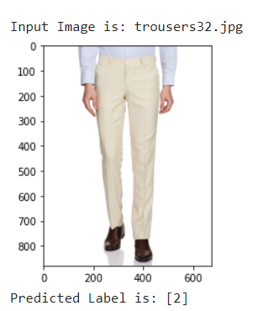
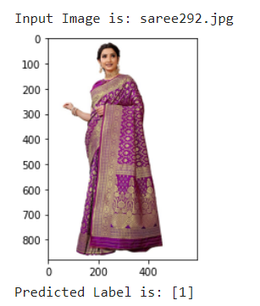
Predicted
Model was able to predict the values approximately right as shown below:

Slide 8
CONCLUSION
Although the model accuracy is of 97% but still some images are not correctly predicted majorly due to small dataset.
Rest the model is performing well.

Slide 9


